Slide 1
GENERATING PWM TYPE SIGNAL WITH VARIABLE DUTYCYCLE ON FPGA
Bachelors in Engineering
(Electronics)
Guided by : Mrs. Ami Sen
Submitted by :
1)MONISHA GANDHI- 806009
2)KOMAL RAINA - 806011

Slide 2
OBJECTIVE:
To Generate PWM signal by comparing input signal and carrier signal with variable duty cycle in VHDL language and load program on FPGA board and observe PWM on Oscilloscope.

Slide 3
Software Components:
XILLINX VIVADO software version 2021.3
Hardware Components:
FPGA Board – ARTIX 7 BASYS3 BOARD
Digital Oscilloscope
Driver IC – ULN2003APG
DC Motor
MOSFET – IRFZ44N

Slide 4
WORKING AND FUNCTIONAL DESCRIPTION
1.PULSE WIDTH MODULATION
Pulse width modulation (PWM) is a technique to provide a logic “1” and logic “0” for a Controlled period of time. It is a signal source involves the modulation of its duty cycle to control The amount of power sent to a load .
We obtain an analog value proportional to the PWM input.
The PWM developed can be used in many diverse and complex applications like robotics, motor and motion control.

Slide 5
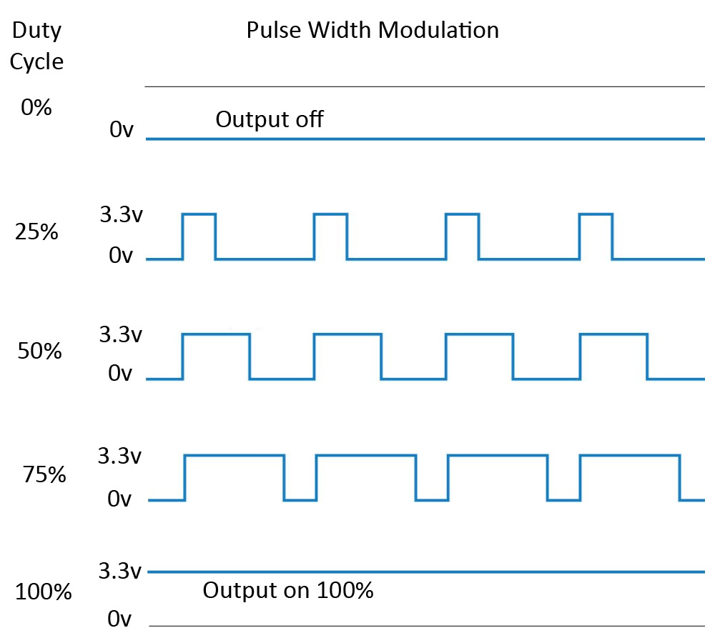
Fig 1 : PWM (The ratio of the pulse width to the cycle duration is called the “duty cycle”.)

Slide 6
2 . FPGA
The FPGA is Field Programmable Gate Array. It is a type of device that is widely used in electronic circuits. FPGAs are semiconductor devices which contain programmable logic blocks and interconnection circuits.
It can be programmed or reprogrammed to the required functionality after manufacturing.
In this project we both are using ARTIX 7 Family FPGA Board.
To Design FPGA Board we are using the programming language called ‘VHDL’.

Slide 7
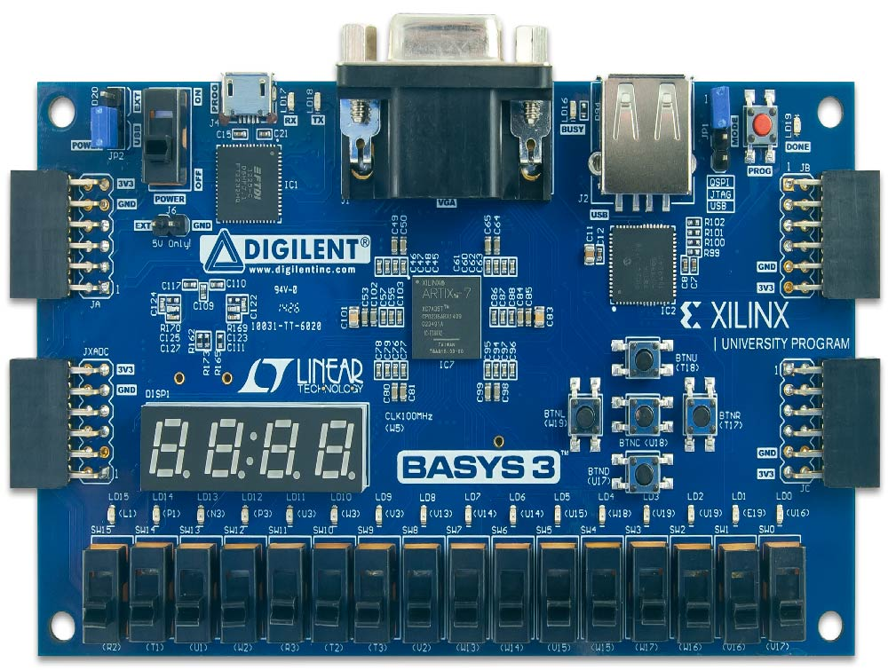
Fig 2 ARTIX 7 BASYS3 FPGA BOARD

Slide 8
Q1. Why we choose FPGA over microcontroller?
Custom Hardware Acceleration
Flexibility and Reconfigurability
Low Latency and Deterministic Timing
Performance
Parallel Processing
High-Speed I/O

Slide 9
they may be more complex and expensive than microcontrollers, their benefits can justify their use in a wide range of applications, from aerospace and defense to telecommunications and industrial automation.

Slide 10
3.Xillinx VIVADO
VIVADO is the design software for AMD adaptive SoCs and FPGAs.
It includes: Design Entry, Synthesis, Place and Route, Verification/Simulation tools.

Slide 11
4.HOW PWM CAN BE ARCHIEVE ON VIVADO
A simple method is used where a sawtooth waveform(Carrier signal) and Variable Duty Cycle is required. A comparator compares between two values in order to generate pulse width modulation signal.
Reset Logic: When the counter reaches its maximum value (end of the PWM period), reset it back to zero to start the next period .To control the duty cycle of the PWM, value will be used to set the high duration of the PWM signal.

Slide 12
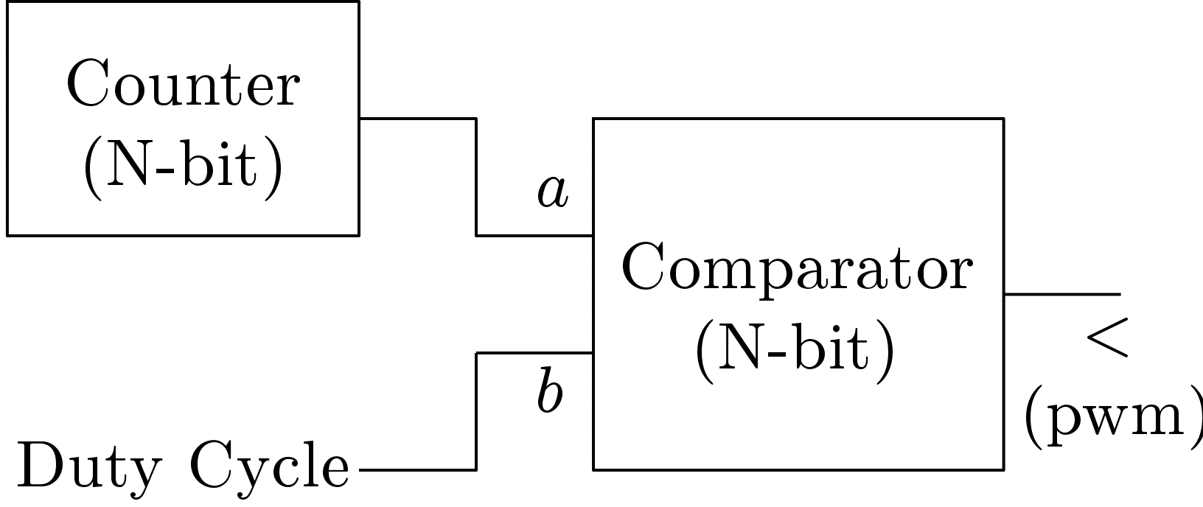
Comparator compares between duty cycle and sawtooth waveform,
If sawtooth waveform< duty cycle , the output register = 1 then PWM = 1;
If sawtooth waveform> duty cycle , the output register = 0 then PWM = 0;
Figure 3 Comparison block of PWM

Slide 13
IMPLEMENTATION DETAILS
Procedure for Implementation:
Design Flowchart
Design Testbench
VHDL Simulation
Run Synthesis
Make a Constrain File
Run Implementation
Generate Bit Stream
Upload to FPGA Board & Hardware Design

Slide 14
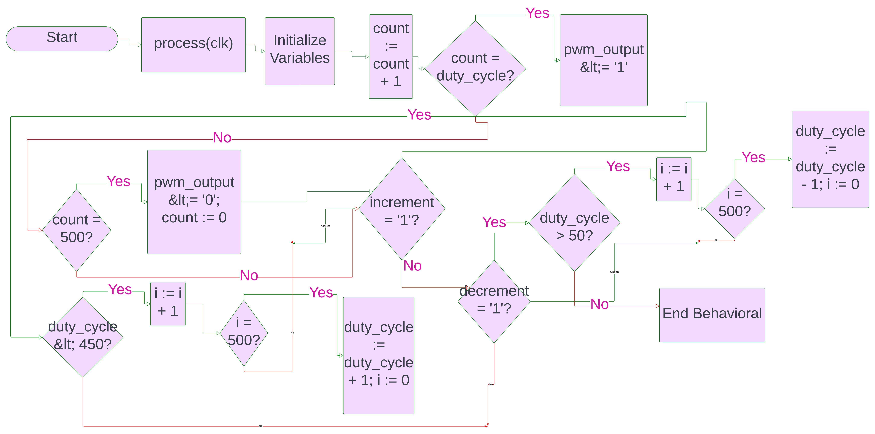
Fig 4 Flowchart Design

Slide 15
In this Flow chart we can change the value of n which is currently 500; it is indirectly indicates switching frequency.
TESTBENCH
At this point, the sample circuit is complete and ready to be processed by synthesis tools. Before processing the design, however, we should take the time to verify that it actually does what it is intended to do. We should run a simulation. Simulating a circuit such as this one requires that we provide more than just the design description itself. To verify the proper operation of the circuit over time in response to input stimulus, we will need to write a test bench.

Slide 16
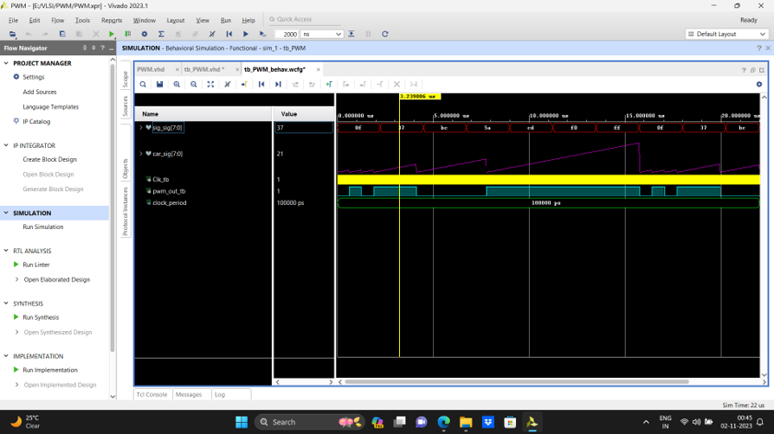
However , we faced an obstacle
Fig 5 carrier changing

Slide 17
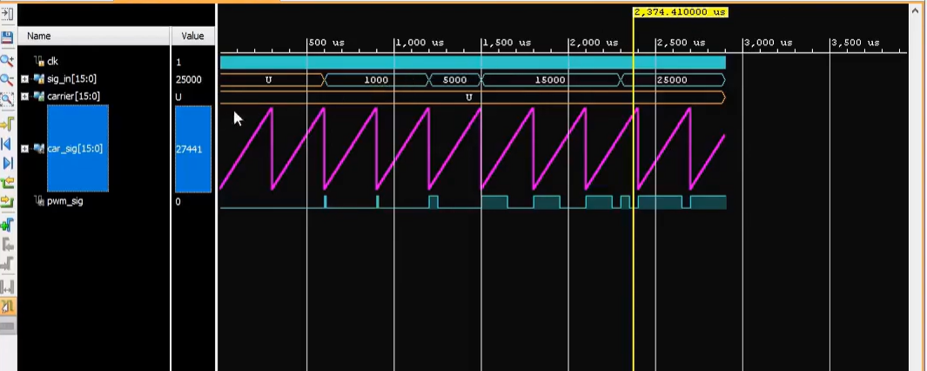
After Modifications we get this:
Fig 6 Test bench

Slide 18
FPGA Constrain for PWM
A Xilinx Design Constraints file or XDC file is needed to interface between your System modules and the Basys3. It hooks up the inputs and outputs of your module to pins, buttons, LEDs, switches, etc. on the board. An XDC file is required to generate configuration bit file.
Generate bit stream
After implementation we need to check if our requirements can fulfill in desired condition on this selected FPGA board.
If generate bit stream shows done that means we can go for open hardware manager otherwise …

Slide 19
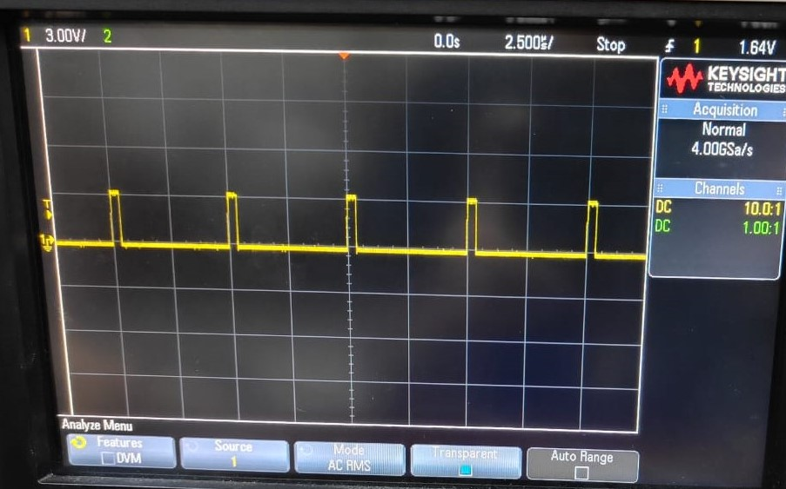
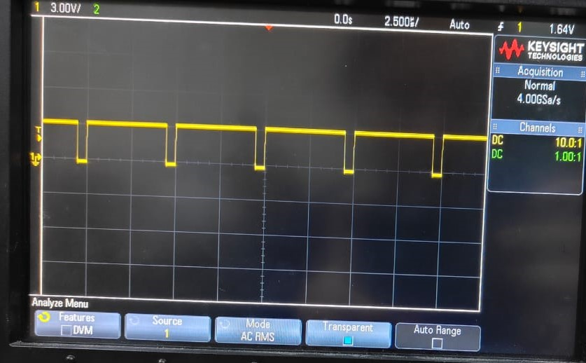
It indicates there is an error in code or the master XDC File.
Now , it is instance to connect FPGA board with our source computer.
So we have observed this waveform in Digital oscillator.
10% duty cycle
92% duty cycle

Slide 20
HARDWARE INTERFACE
Speed control of DC motor via PWM
using FPGA board

Slide 21
Why we are doing speed control?
FPGAs are commonly used in industrial applications for motor control where precise speed control, real-time processing, and high performance are required. Some specific applications where FPGA-based motor control is prevalent in industrial settings includes:

Slide 22
representative case:
Electric Vehicles (EVs) and Hybrid Electric Vehicles (HEVs)
Renewable Energy Systems
Industrial Robotics
HVAC Systems(heating, ventilation, and air conditioning)
Power Electronics

Slide 23
MOTOR
DRIVER IC
ULN2003APG
MOSFET
PWM Signal
VCC
GND
Fig 9 Circuit Design

Slide 24
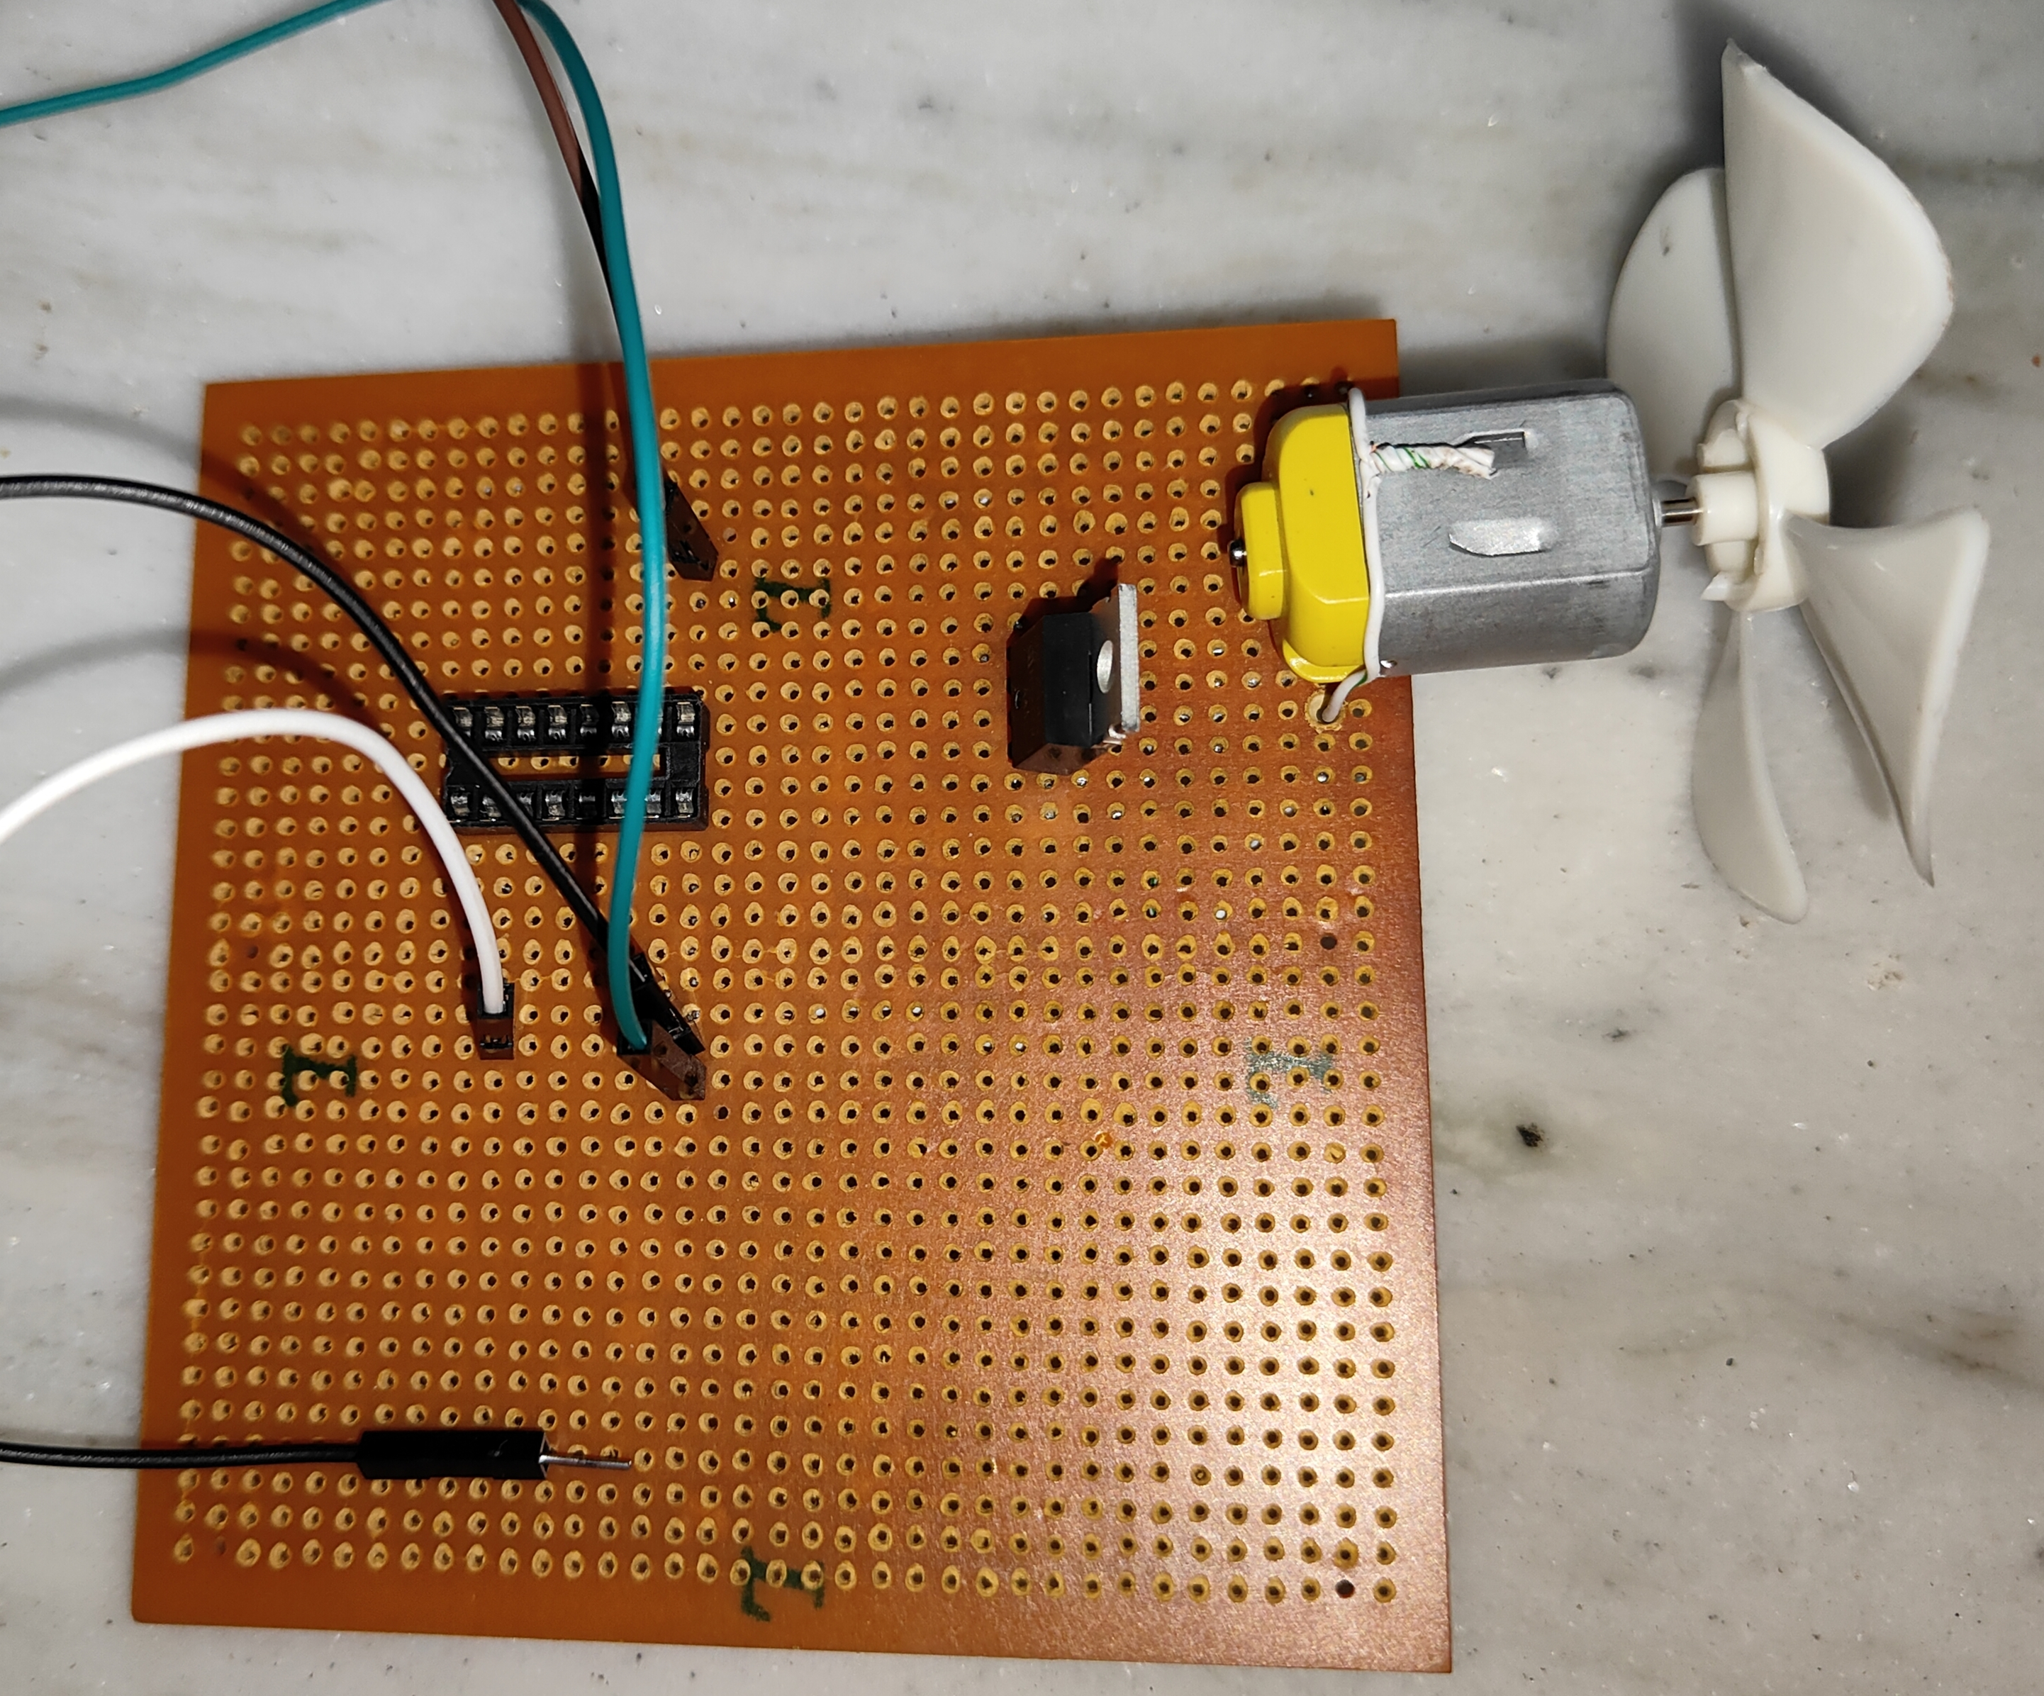
Fig 10 Speed control of DC motor

Slide 25
Limitations
Clock Jitter and Noise
Switching Losses
Resource Utilization

Slide 26
Conclusion
Using FPGAs to control motor speed with PWM is like giving motors a smart, easy-to-use tool. It's as if they're getting a fancy remote control that helps them work smoothly and save energy. This setup is a straightforward way to make motors perform better in factories and industries.

Slide 27
References
Stephen Brown, “Fundamentals of digital logic with VHDL design,” July 2002.
Gwaltney, “FPGA Implementation of controls,” 2003.
http://www.digilentinc.com (Xilinx I/O board).
Karen Parenell, Nick Mehta,“ Programmable logic design Quick start Hand Book,
”Xilinx, Second edition, January 2002

Slide 28


